Slide 1
Three Process Models
Prof. Dr. Dirk Riehle
Friedrich-Alexander University Erlangen-Nürnberg
AMOS C02
Licensed under CC BY 4.0 International
Notes:
It is Friedrich-Alexander University Erlangen-Nürnberg – FAU, in short.
Corporate identity wants us to say “Friedrich-Alexander University”.

Slide 2
Software Process Model [DR]
A software process
  Is a process perfomed with goal of creating and evolving software
A software process model
  Is a model of a software process
Software process model elements
  Comprises roles, practices, and artifacts
  That describe the valid software process instances

Slide 3
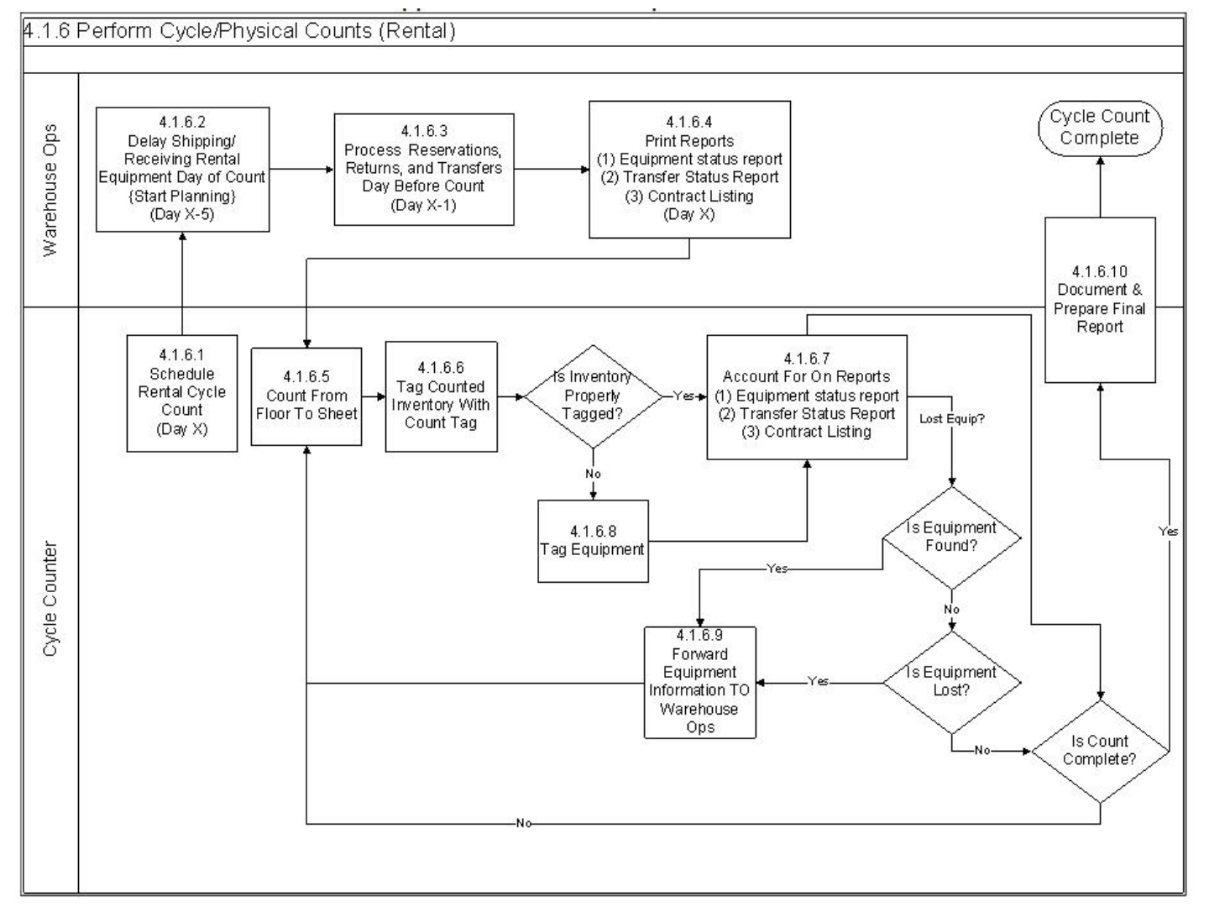

Slide 4
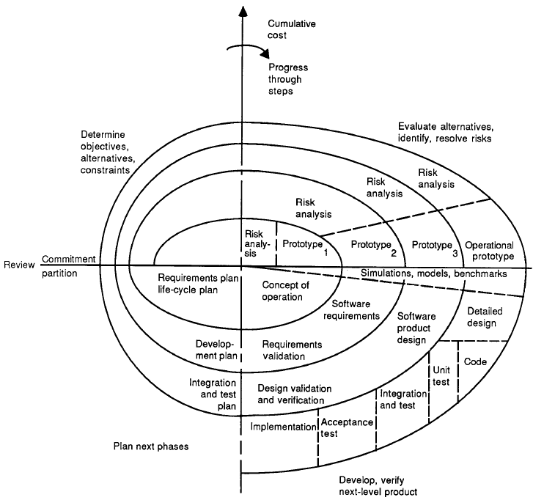
[B88]

Slide 5
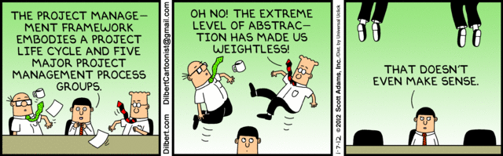
Project Management Frameworks

Slide 6
Key Activities in Software Engineering
Planning
Execution
Review
Release

Slide 7
Example of a Software Product Life-Cycle
incubate
develop
maintain
1st
release
start
mature
retire
I
D
M
I: Incubation
D: Development
M: Maintenance
release
release

Slide 8
(One Version of) The Magic Triangle
Scope
Cost
Time
Quality
Cost is usually assumed fixed (defined team).
Because “adding manpower to a late project makes it later.” [B75]

Slide 9
Three Process Models
Plan-Driven
Agile Methods
Open Source

Slide 10
Plan-Driven Development
Linear, phase-oriented, software process models
  Intend to minimize risk through up-front planning
  Expect only one iteration, start to finish, not many
  Equate phases with activities
Examples: Waterfall, V-Modell, RUP
start
Planning
Execution
Review
Release
end
6 months – 5 years
time

Slide 11
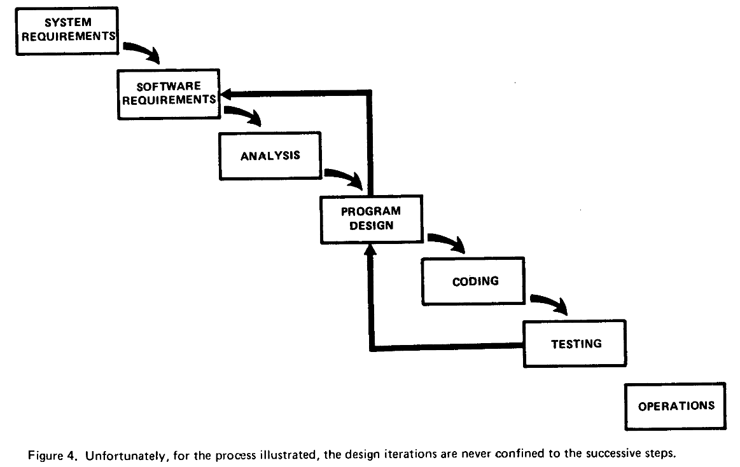
The Waterfall Model [R04]

Slide 12
Planning in Plan-Driven Development
Project definition
Requirements analysis
System analysis
Contract negotiation
...

Slide 13
Execution in Plan-Driven Development
Architecture definition
System design
User interface design
Implementation
Integration
...

Slide 14
Review in Plan-Driven Development
System test
Acceptance test
Contract validation
...

Slide 15
Release in Plan-Driven Development
Hand-over
Deployment
...

Slide 16
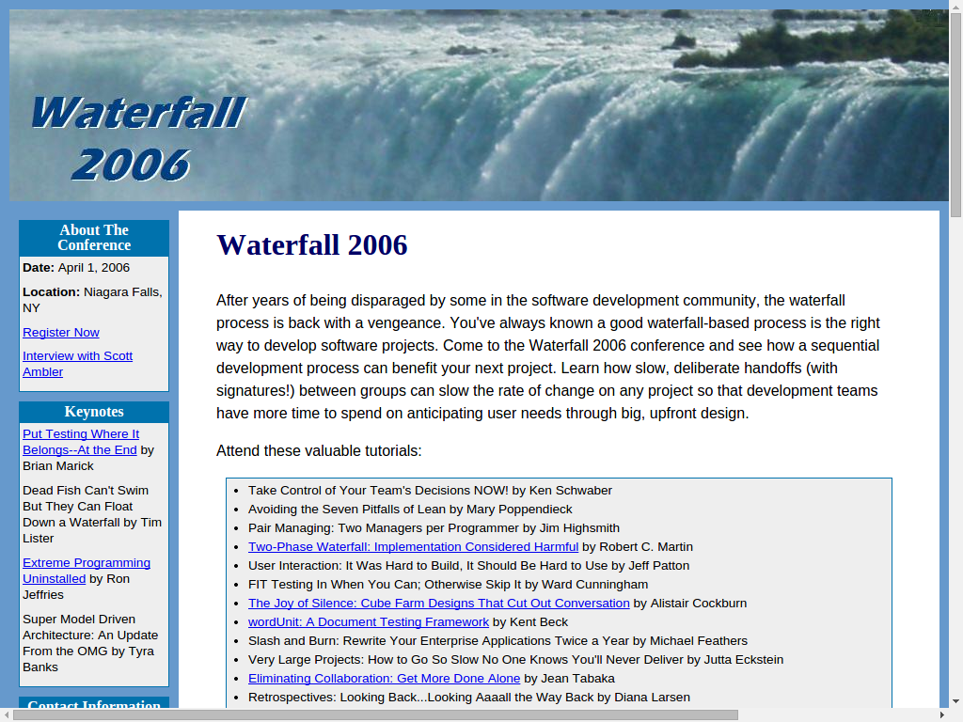

Slide 17
Aphorisms on Predicting and Planning
“Prediction is very difficult, especially about the future.”
  Attributed to Niels Bohr, date unknown
“Kein Plan überlebt die erste Feindberührung.”
  Helmuth (Karl Bernhard) von Moltke, date unknown
“Plans are worthless, but planning is everything.”
  Dwight D. Eisenhower, Nov 14, 1957

Slide 18
Lesson from Plan-Driven Development
Phases ≠ Activities
(Activity = performing a practice)

Slide 19

Video on Predictability of Processes

Slide 20
Video Lesson
It is impossible to predict such a flight
  Little bumps on the way have big consequences
  Little wind gusts will get you way off track
Executing a plan without steering is dangerous
  There is no way to ensure you will achieve the desired outcome
  Belief in flawless execution is, well, flawed and risky

Slide 21
Agile Methods
Invented during the late 1990ties
  In response to failure of plan-driven methods
  Driven by consultants as a significant business opportunity
Repeated iteration over short linear process models
  Defined equal-length iterations with deliverables
  Consistent involvement of users for feedback

Slide 22
Examples of Agile Methods
Scrum
XP (eXtreme Programming)
Adaptive Software Development
The (set of) Crystal Methods
Feature-Driven Development
Pragmatic Programming

Slide 23
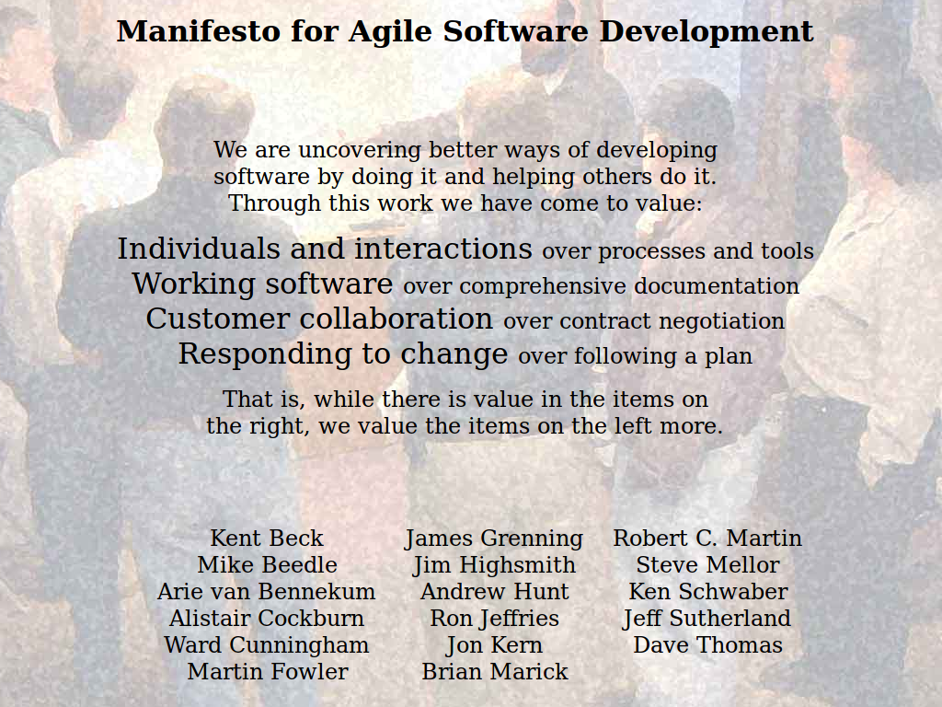

Slide 24
Principles of the Agile Manifesto [A01]
Individuals and Interactions
(over Processes and Tools)
Working Software
(over Comprehensive Documentation)
Customer Collaboration
(over Contract Negotiation)
Responding to Change
(over Following a Plan)

Slide 25
Individuals and Interactions over ...
Individuals
  Trust people
  Allow for self-organization
  Adjust process to people
Interactions
  Get results from collaboration
  Get innovation from people
Processes
  Control people
  Enforce a rigid process
  Adjust people to process
Tools
  Get results from using tools
  Keep people aligned with tools

Slide 26
Working Software over ...
Working Software
  Get feedback quickly
  Learn from working software
  Steer project from feedback
  Create incremental progress
Comprehensive Docs
  Wait until the end
  Don't learn at all along the way
  Follow plan until the end
  Delay results until the end

Slide 27
Customer Collaboration over ...
Customer Collaboration
  Collaborate with customers
  Steer using customer feedback
  Create feedback rhythm
  Allow for change
Contract Negotiation
  Minimize customer contact
  Follow contract-based plan
  Avoid customer feedback
  Stick to agreement

Slide 28
Responding to Change over ...
Responding to Change
  Adjust to changing reality
  Deliver what customer needs
Following a Plan
  Stick to outdated reality
  Deliver what was negotiated

Slide 29
Agile Development Process
Succession of equal-length iterations (“time-boxes”)
Intervention points are during planning and review
User feedback only available during review
Iteration n-1
Iteration n
Iteration n+1
...
...
P
E
3R
P
E
3R
P
E
3R
1-4 weeks
1-4 weeks
1-4 weeks
time
P: Planning
E: Execution
3R: Review, release, and retrospective

Slide 30
Short Iterations and User Feedback
Short iterations
  Short iterations lead to focus on high-value features first
  Established well-worn rhythm is sustainable, avoids burnout
  Partial functionality is better than none
User feedback
  User feedback helps team steer product to meeting needs right
  Feedback loop ensures that problems surface early
  Feedback helps recognize and realize new innovative features

Slide 31
Plan-Driven vs. Agile Processes
T1
S5
T1
Plan-Driven
Agile Methods
T2
T2
S3
T3
S4
T3
S2
T4
T4
S5
S1
S1
T5
T5

Slide 32
Plan-Driven vs. Agile Work Rhythms
Plan-driven methods
Long iterations
time
Agile methods
Short iterations
time

Slide 33
Agile Methods and Discipline
Agile methods
are high-discipline
(more so than plan-driven methods)

Slide 34

Legal Definition of Open Source
Definition of open source software
  Software that is provided under an OSI-approved license
  OSI = Open Source Initiative, http://opensource.org
  Tried (but failed) to register the “open source” trademark
Characteristics of an OSI-approved license
  Source code is available and accessible
  Modifications of code are allowed
  Distribution of source and binary code is unrestricted
Free software is (mostly) a subset of open source software
  Historically, free software predates open source software
  Invented “copyleft” (reciprocal) licensing

Slide 35
Open Source (Process)
“Open source is a development method for software that harnesses the power of distributed peer review and transparency of process. The promise of open source is better quality, higher reliability, more flexibility, lower cost, and an end to predatory vendor lock-in.” [O12]

Slide 36
Principles of Open Collaboration [R+09]
Egalitarian
Meritocratic
Self-organizing

Slide 37
Traditional Work vs. Open Collaboration
Traditional work
  Hierarchical
    Closed and hidden silos
    Assigned to project
  Status-oriented
    Public + private discussions
    Hierarchical status decides
  Assigned tasks
    Prescribed process
    Prescribed jobs
Open collaboration
  Egalitarian
    Open for contribution
    Everyone can contribute
  Meritocratic
    Public discussion process
    Decisions based on merit
  Self-organizing
    People find their project
    People create their process

Slide 38
Comparison of Process Model Types
Need to Change
No
Yes
Plan-Driven
Agile Methods
Open Source
Plan-Driven
Agile Methods
Open Source
No
Need to Scale
Agile Methods
Plan-Driven
Open Source
Open Source
Yes

Slide 39
Quiz on Types of Projects
Which process model fits Fixed-Price-Projects?
  Plan-driven process
  Agile methods process
  Open source process
Which process model fits Time-and-Materials-Projects?
  Plan-driven process
  Agile methods process
  Open source process
Which process model fits Inter-Firm-Collaboration-Projects?
  Plan-driven process
  Agile methods process
  Open source process

Slide 40
Review / Summary of Session
Key activities in software engineering
Main categories of process models
  Plan-driven methods
  Agile methods
  Open source
Plan-driven vs. agile methods
  Predictability of the future
  The agile manifesto

Slide 41
Thank you! Questions?
dirk.riehle@fau.de – http://osr.cs.fau.de
dirk@riehle.org – http://dirkriehle.com – @dirkriehle
DR

Slide 42
Credits and License
Original version
  © 2012-2019 Dirk Riehle, some rights reserved
  Licensed under Creative Commons Attribution 4.0 International License
Contributions
  ...

